Slide 1
Sharing Session
Mask-RCNN using Detectron2
We will learn together about some of computer vision problems, and will try Mask-RCNN architecture to solve the instance segmentation problems
Benedictus Aryo

Slide 2
Agenda
Computer Vision Problems
RCNN Family
Mask RCNN
Why Detectron2
Practice using Detectron 2
Training using Detectron2 (optional)

Slide 3
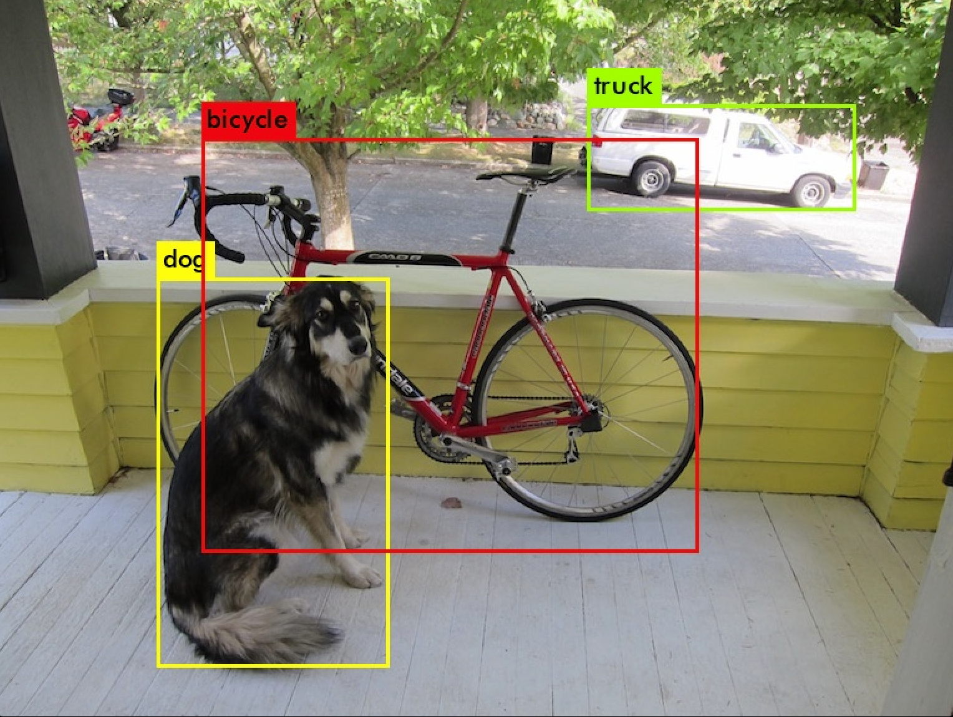
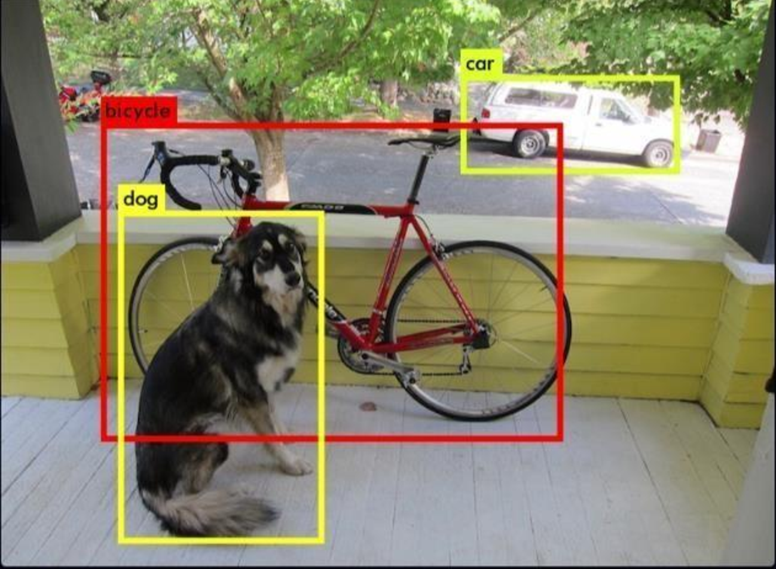
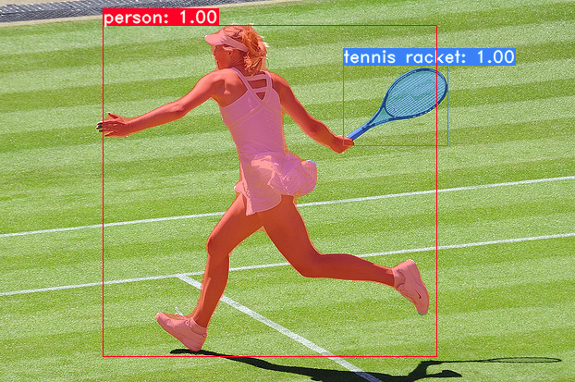
In short..
This is Not
Faster-RCNN
This is Not
Mask-RCNN
YOLOv3:An Incremental Improvement. Joseph Redmond, Ali Farhadi. 2018
YOLACT: Real-time Instance Segmentation. Daniel Bolya, et. al. 2019

Slide 4
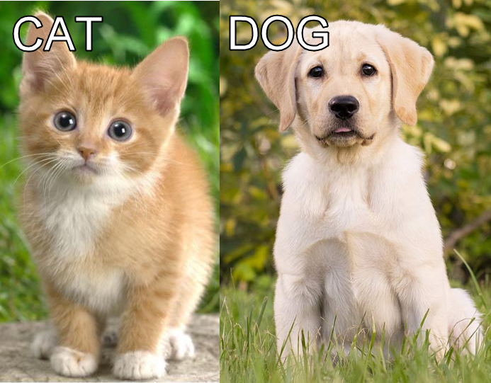
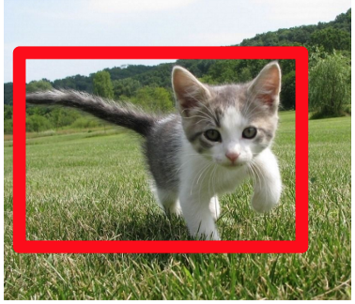
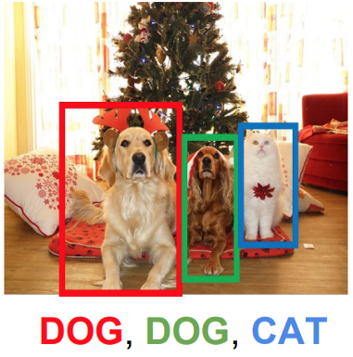
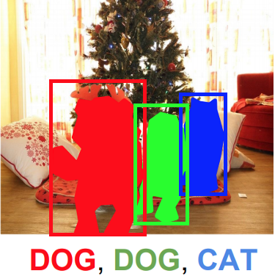
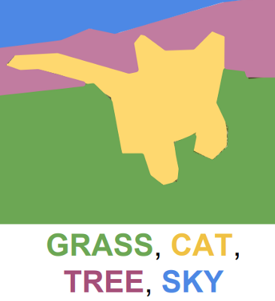
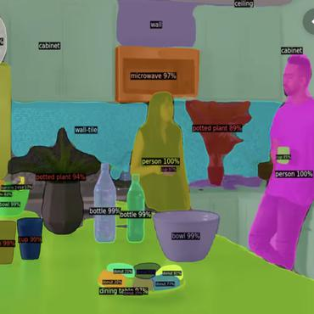
Problems in Computer Vision Image Recognition
Image Classification
Classification + Localization
Object Detection
Instance Segmentation
Semantic segmentation
Panoptic segmentation

Slide 5
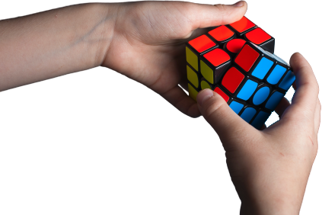
Understanding problems is essential to solving the problems

Slide 6
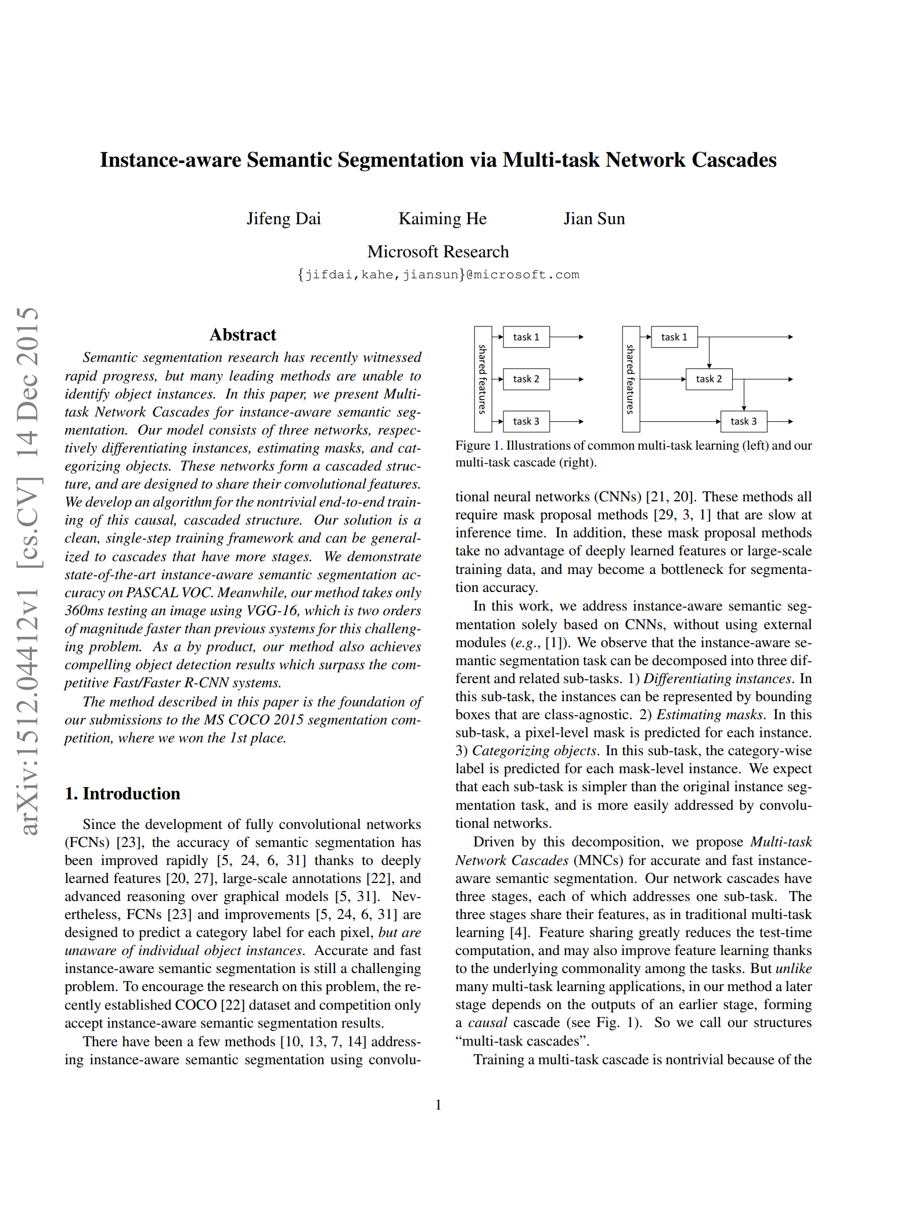
Instance-aware Semantic Segmentation

Slide 7
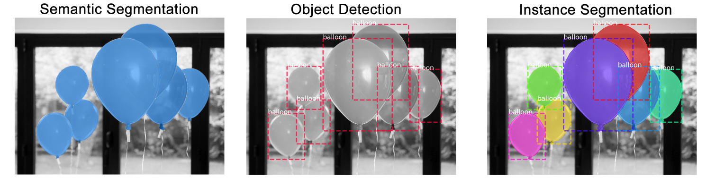
The differences

Slide 8
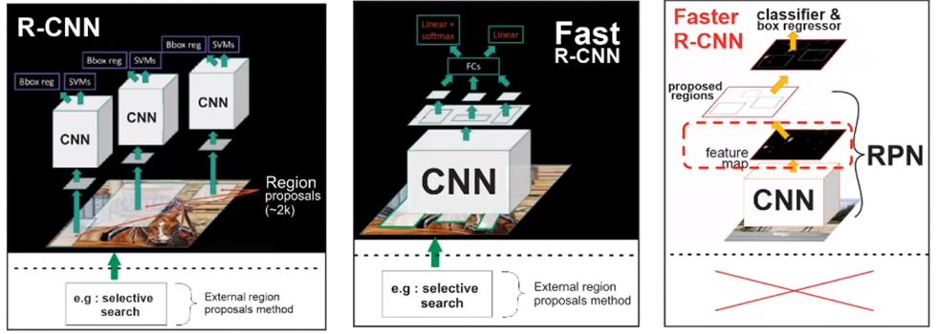
RCNN Family for Object Detection

Slide 9
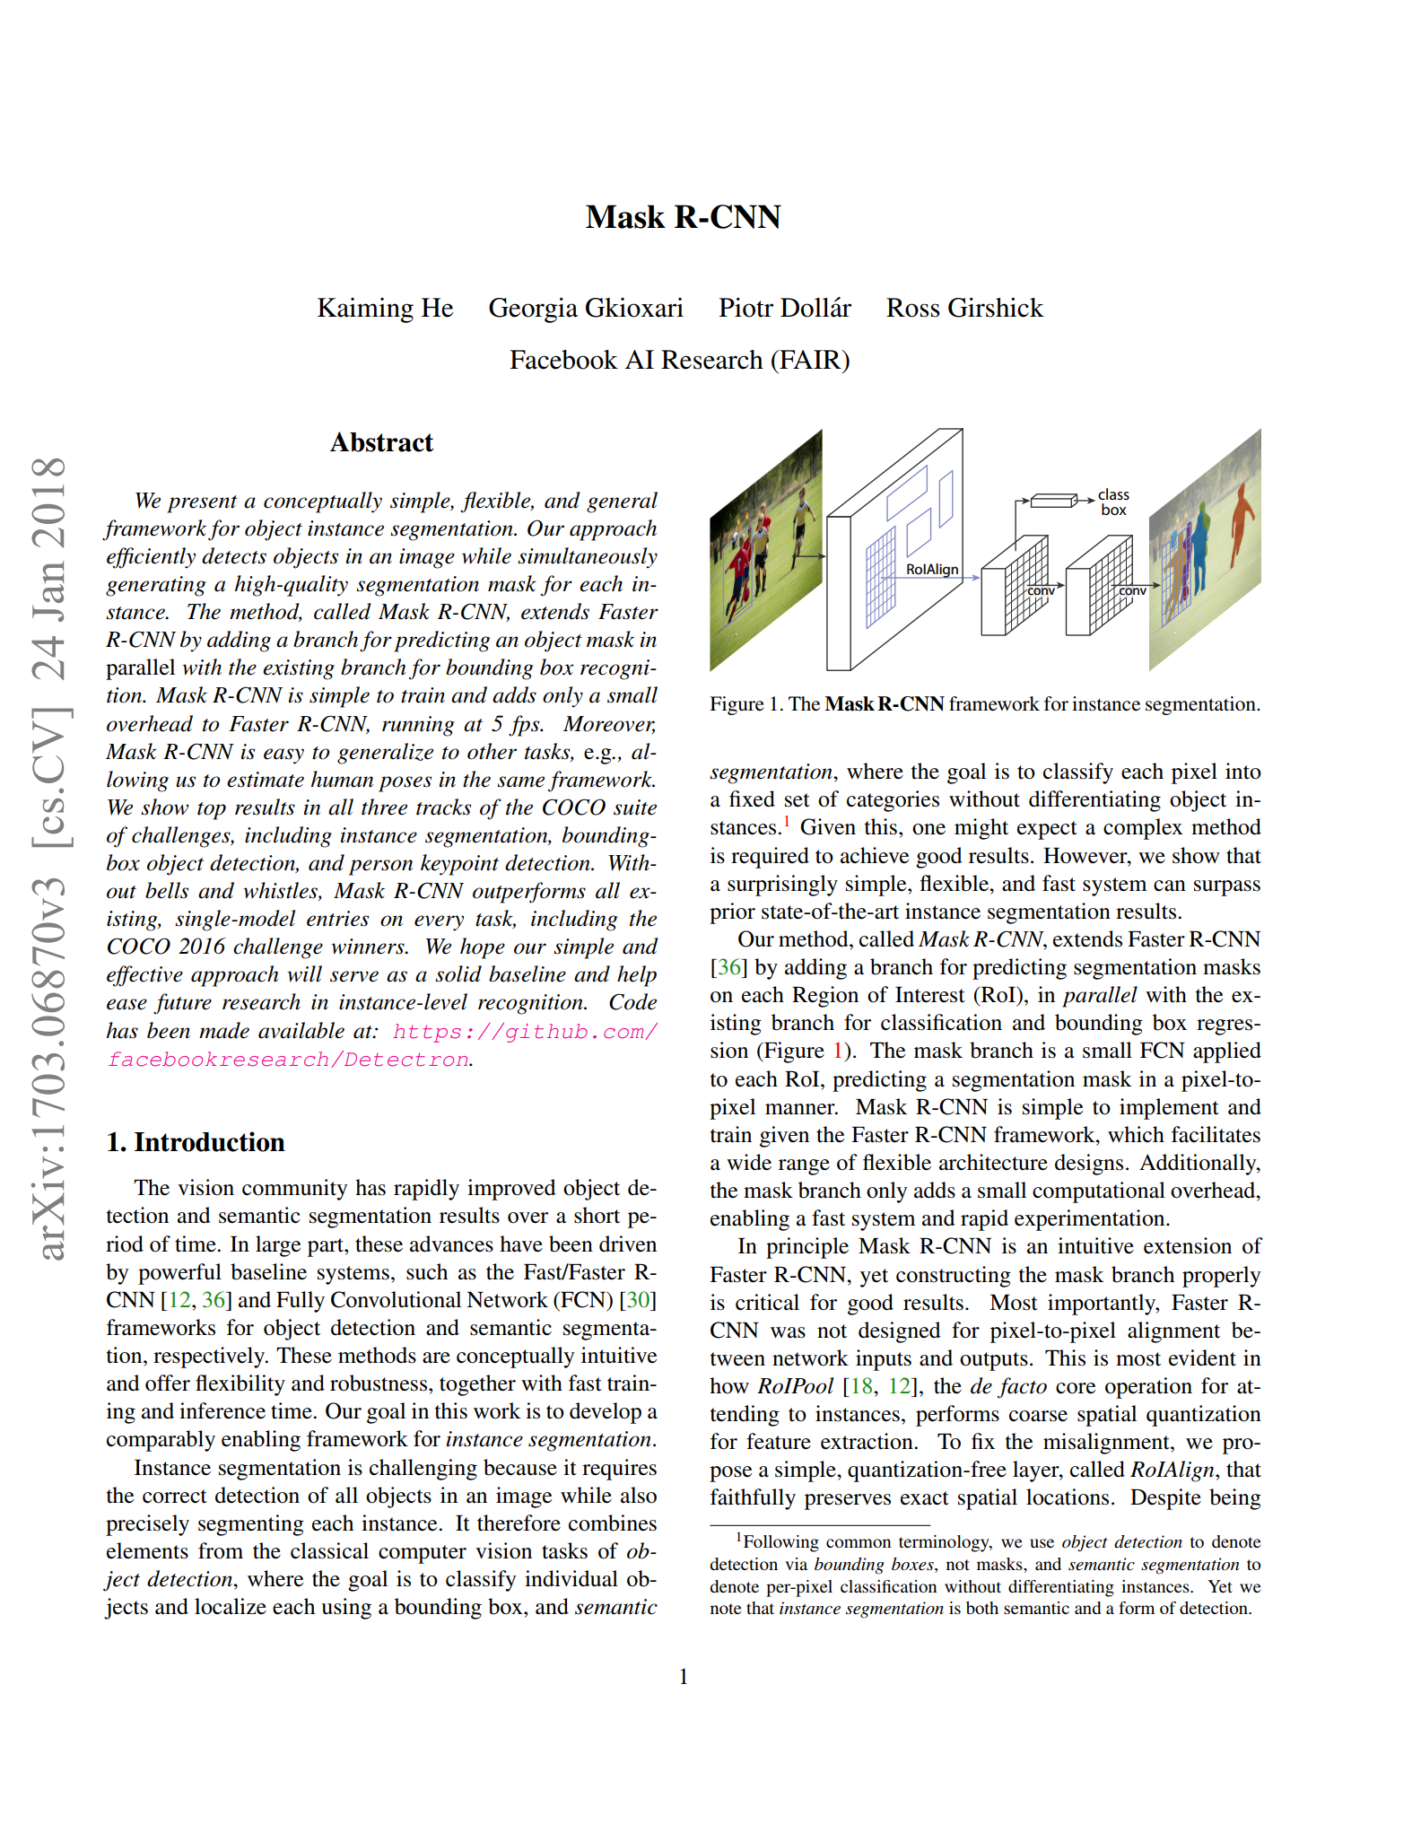
Mask R-CNN
Best Paper Award (Marr Prize) at the 16th International Conference on Computer vision (ICCV) 2017

Slide 10
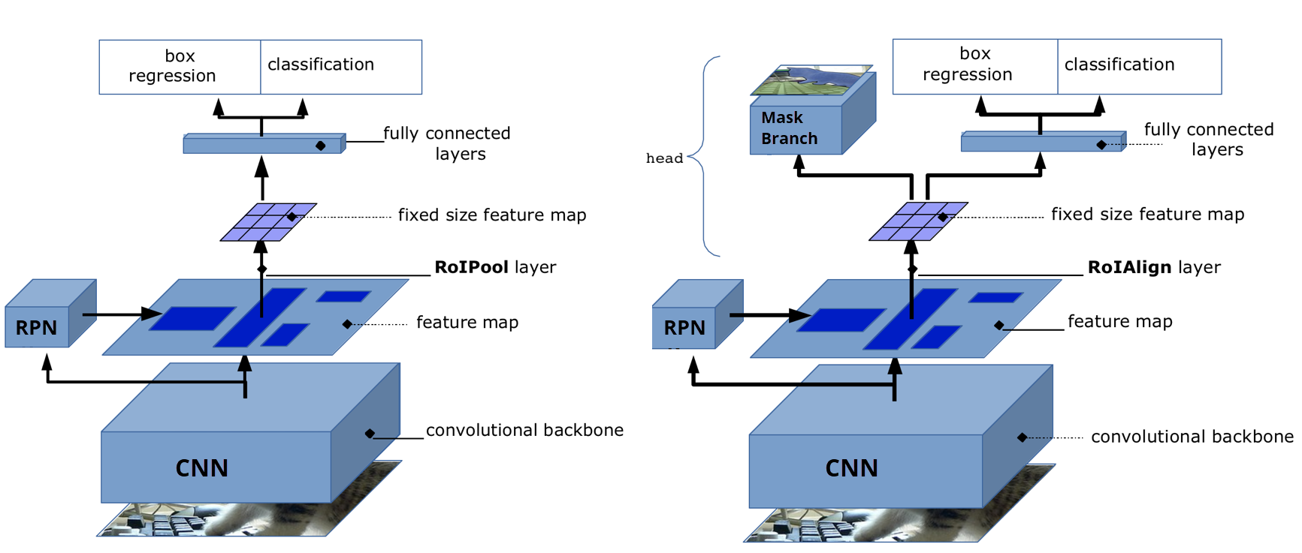
Faster R-CNN vs Mask R-CNN
Model Architecture

Slide 11
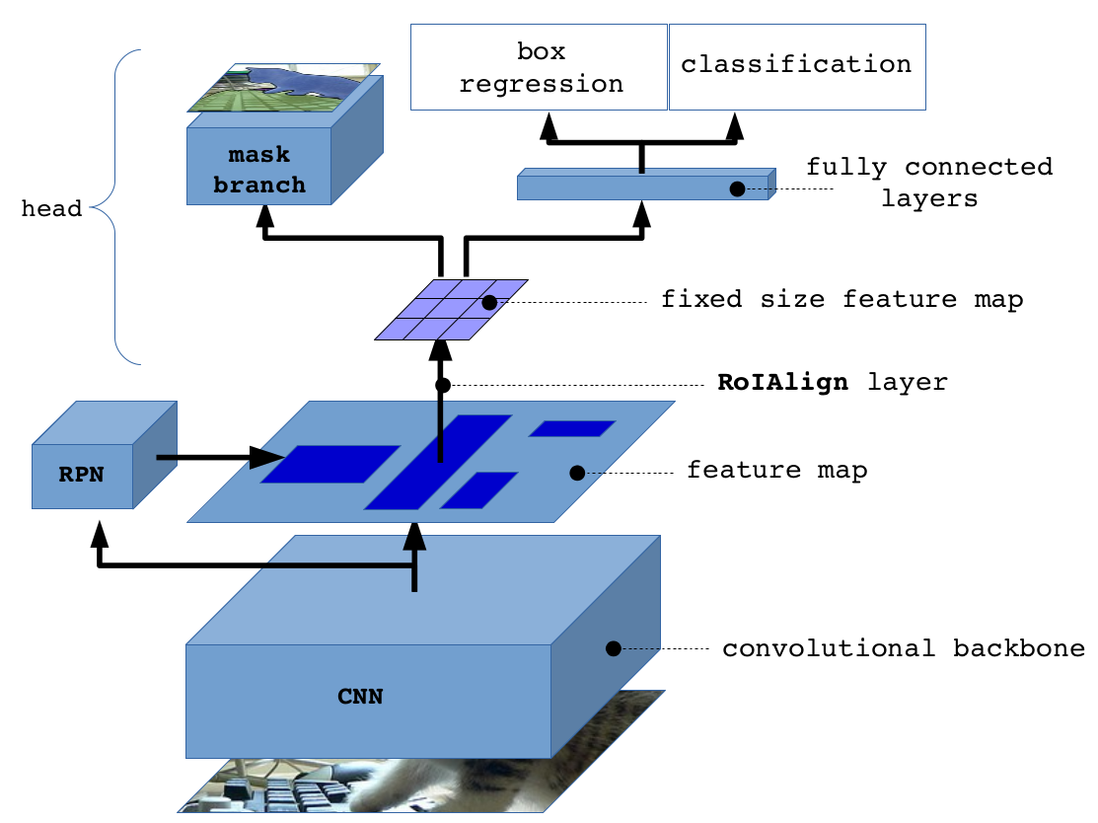
Mask R-CNN Architecture
Mask
Faster R-CNN

Slide 12
Mask R-CNN Implementation
Facebookresearch/detectron
Matterport/Mask_RCNN
Original Implementation from paper
Using Caffe Framework
Deprecated, move to detectron2 which is a ground-up rewrite of Detectron in PyTorch
Most Popular implementation of Mask R-CNN
Using Tensorflow v1 Framework
No Longer maintained, many compatibility issue to new tensorflow version

Slide 13

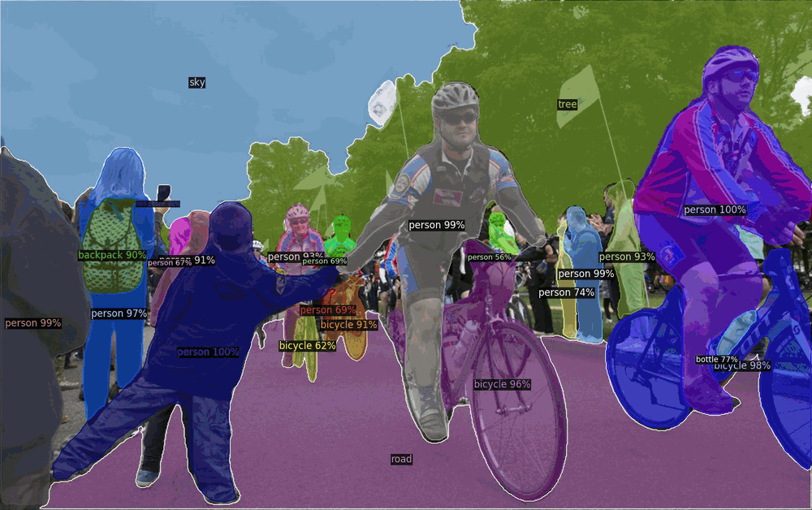
Mask R-CNN Implementation using
Detectron2 is Facebook AI Research's next generation software system that implements state-of-the-art object detection algorithms. It is a ground-up rewrite of the previous version, Detectron, and it originates from maskrcnn-benchmark.

